Slide 1
IBM CAPSTONE PROJECT – The Battle of Neighborhoods:
Cluster Analysis of Paris

Slide 2
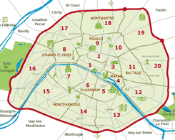
Problem
Help people moving to Paris, France discover which of the 20 districts is more Eco-friendly
Clustering Paris neighborhoods using various data in order to find neighborhoods that have "Greener" criteria
Solution

Slide 3
Data
latitudes, and longitudes and total area of each borough (https://opendata.paris.fr/)
Historical air quality index
(https://breezometer.com/historical-air-quality-data)
Locations of Public open spaces and Eco-friendly businesses via the Foursquare API
Green spaces and the amount of trees in every borough (https://opendata.paris.fr/)
Vegan restaurants via the google API (https://developers.google.com/places/)

Slide 4
Methodology
- Collecting data found in different API's and sites
- Cleansing the data when necessary
- Characterizing and visualizing the data
- K-means clustering method implementation, in aim to group the similar data points together and discover underlying patterns.

Slide 5
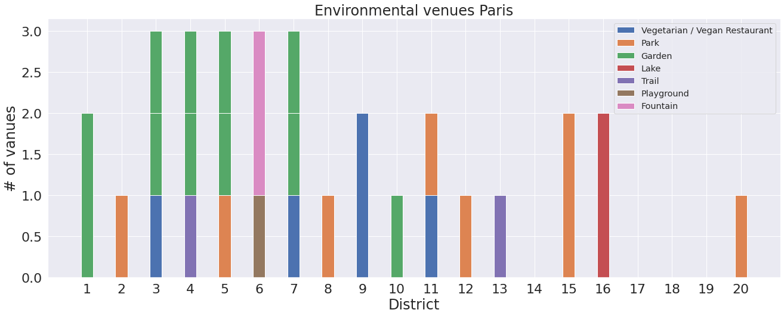
visualizing the data: FourSquare
Data too sparse, won’t be taken into account

Slide 6
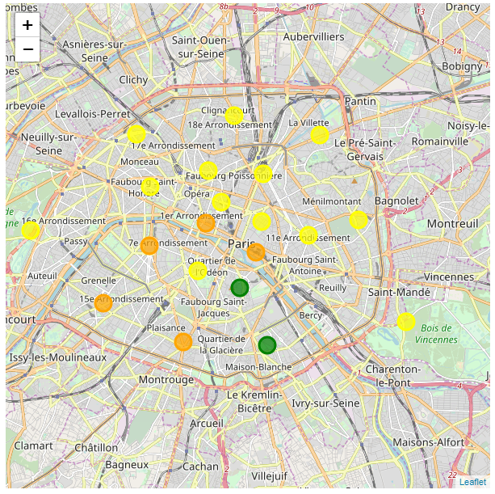
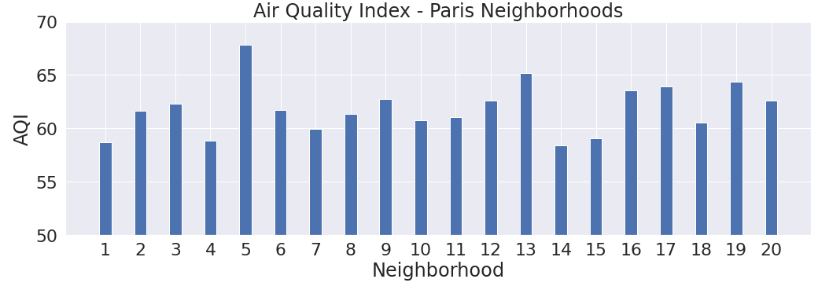
visualizing the data: Air Quality Index
Air Quality map - Paris (21-24/3/2020)
(Green - AQI > 65 ; Yellow - 06<AQI<65 ; Orange - AQI < 60)

Slide 7
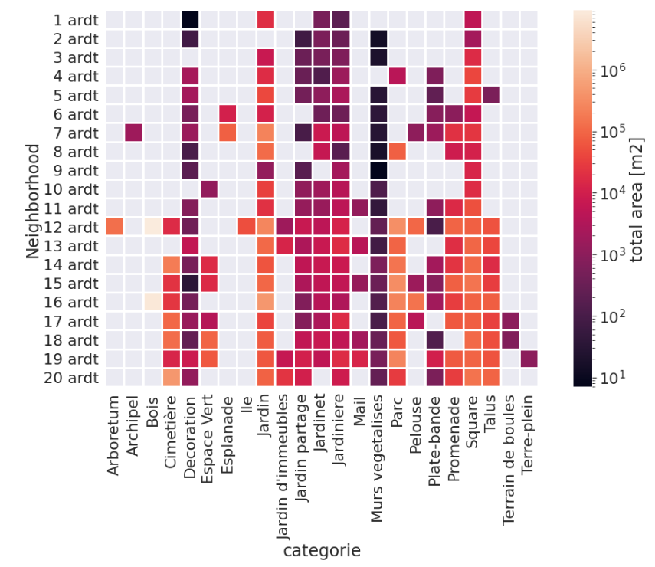
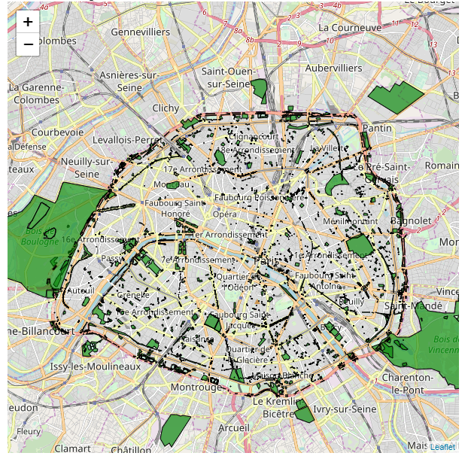
visualizing the data: Land uses

Slide 8
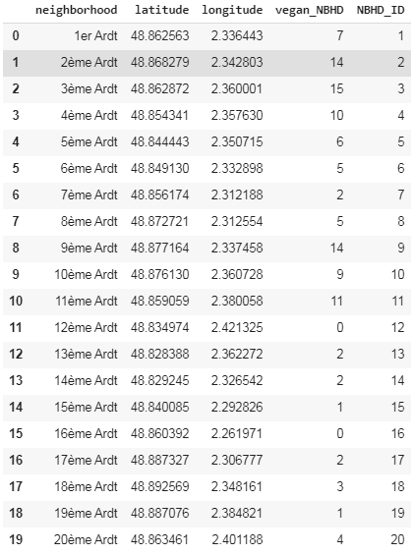
visualizing the data: Vegan Restaurants

Slide 9
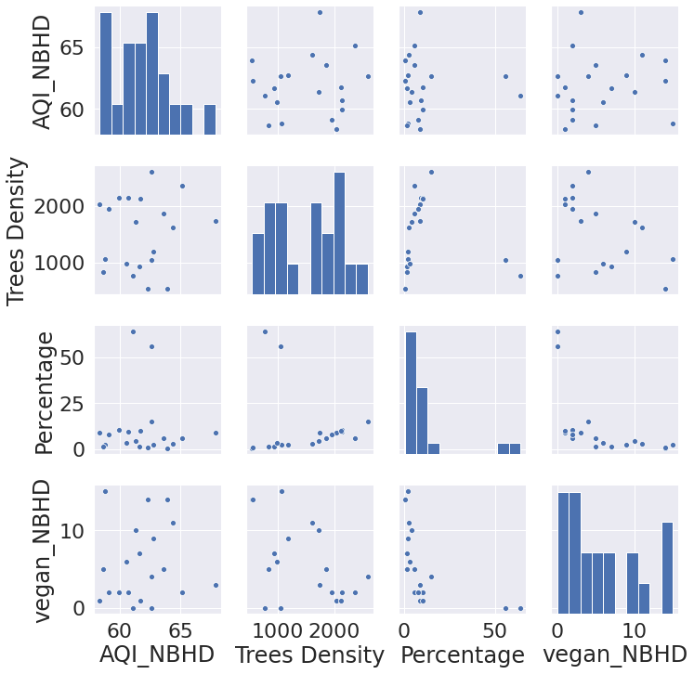
visualizing the data: Pair plot between parameters

Slide 10
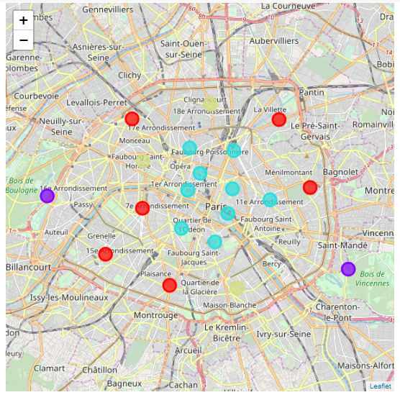
K-Means Clustering
Eco-Clusters - Paris
(Cluster 0 - Purple, Cluster 1 - Light Blue, Cluster 2 - Beige, Cluster 3 - Red)
Labels | AQI | Trees Density | Green area Percentage | Vegan restaurants
0 | 61.9 | 911 | 60 | 0
1 | 61.6 | 1047 | 2 | 10
2 | 65.5 | 1992 | 7 | 3
3 | 60.4 | 2165 | 10 | 2

Slide 11
Conclusions:
12th and 16th Districts - adjacent to forests, but their air quality is relatively poor and have low number of vegan restaurants.
1-6, 9-11 Districts, largest number of vegan restaurants, but suffer from poor air quality, low percentage of green areas and low density of trees.
8th, 13th and 18th Districts best air quality relatively, large number of trees, but lacking green areas and vegan restaurants.
7th, 14th, 15th, 17th, 19th and 20th Districts all suffer from low air quality, low percentage of green areas and small number of vegan restaurants.

